Slide 1

laravel

Slide 2
INTRODUCTION
Laravel is a popular PHP web application framework designed to simplify web development with a modular structure, elegant syntax, and built-in-features. It was created by Taylor otwell in 2011

Slide 3
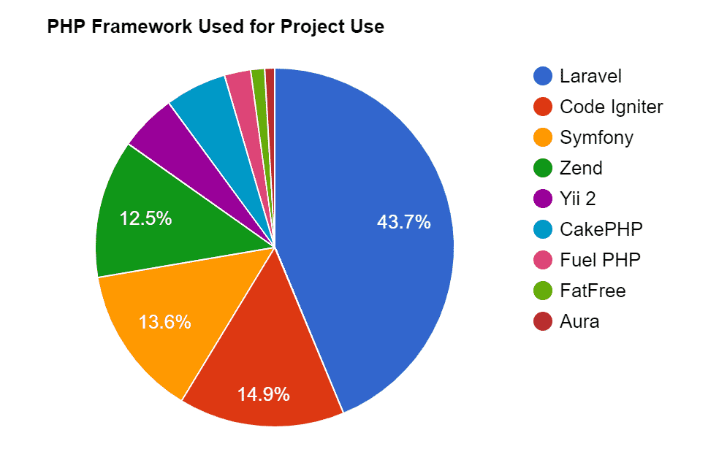
WHY LARAVEL ?
Simplicity: Laravel has a simple and elegant syntax that makes it easy to learn and use. It follows the Model-View-Controller (MVC) architectural pattern, which separates the application logic, presentation, and data into distinct layers, making it easier to maintain and test code.
Modularity: Laravel is designed with modularity in mind, which means that it is highly customizable and adaptable. It comes with a wide range of built-in features, such as routing, middleware, database management, authentication, and more, that can be easily added or removed depending on the needs of the application.
Built-in features: Laravel has a rich set of built-in features that help streamline the web development process, including the Blade templating engine, Eloquent ORM, Artisan command-line interface, and more. These features help developers to write cleaner, more maintainable, and efficient code in less time.
Active community: Laravel has a large and active community of developers, which means that there is a wealth of documentation, tutorials, and other resources available to help developers learn and use the framework. The community also contributes to the development of the framework by providing feedback, reporting bugs, and creating packages and extensions to add new functionality.

Slide 4

Laravel Features
Routing
Middleware
Blade template engine
Eloquent ORM
Artisan command line interface
Security features

Slide 5
Getting Started with Laravel
Installation
First, download the Laravel installer using Composer:
~ composer global require laravel/installer
~ laravel new test
~cd example-app
~php artisan serve

Slide 6
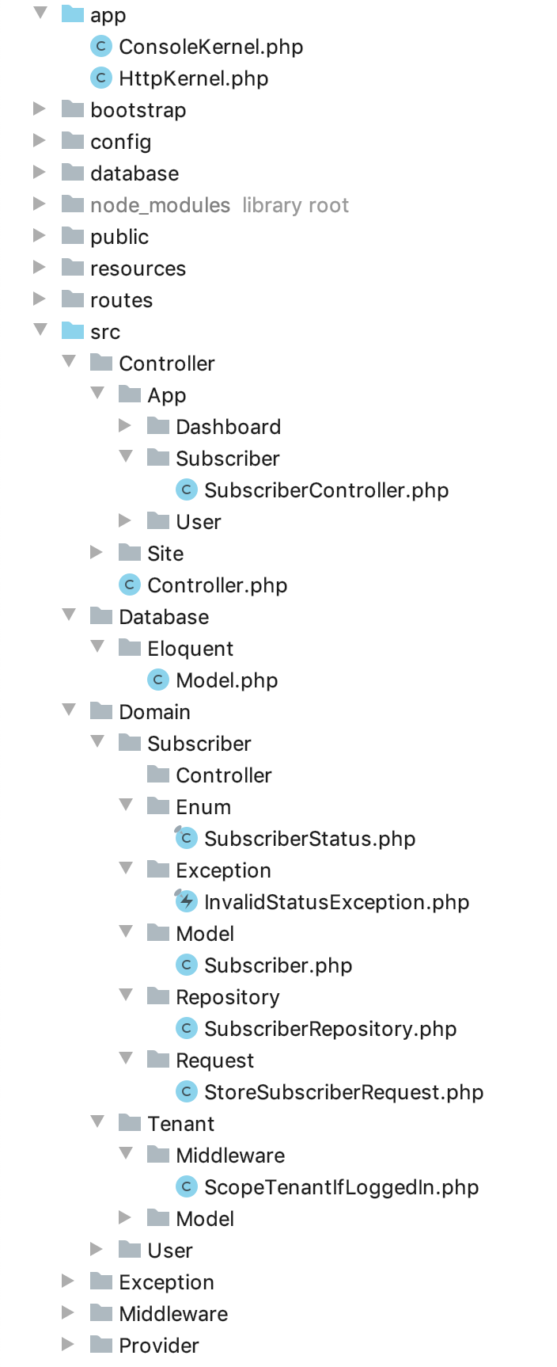
Directory structure
app/Http folder contains the Controller, Middlewares and Kernel file
All model should be located in app/Models folder
All the config files are located in app/config folder
Database folder contains the migrations

Slide 7
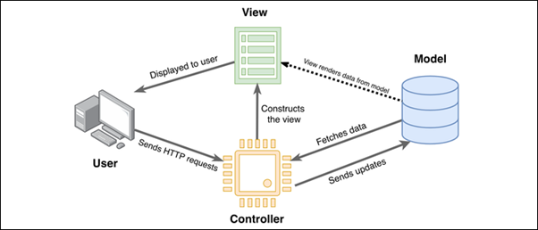
MVC
MVC is a software architectural pattern commonly used for developing user interface that divide the related
program logic into a three interconnected elements.

Slide 8
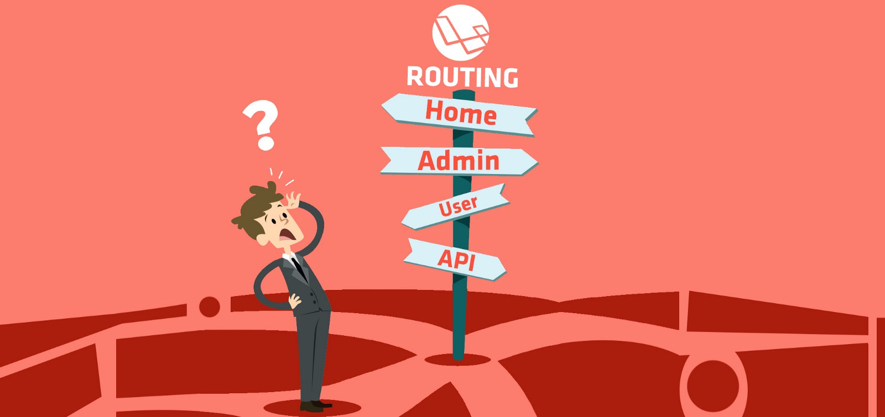
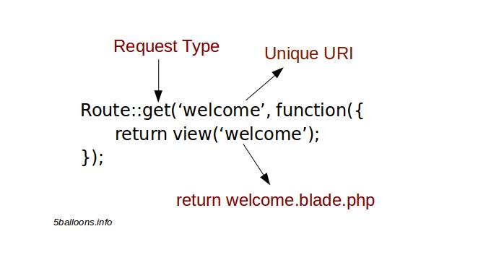
Routing
The route is a way of creating a request URL for your application
In Laravel, routes are created inside the routes folder. They are created in the web.php file for websites. And for APIs, they are created inside api.php

Slide 9
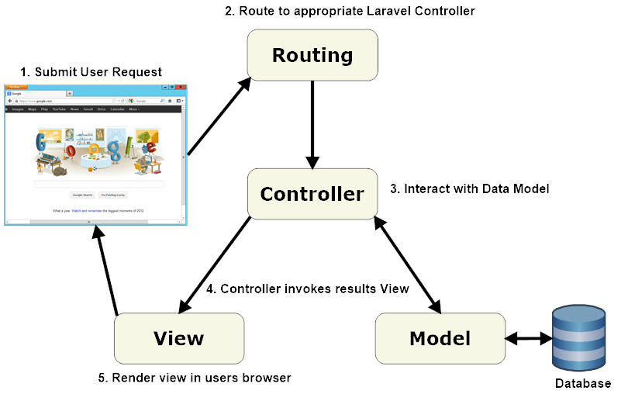

Slide 10
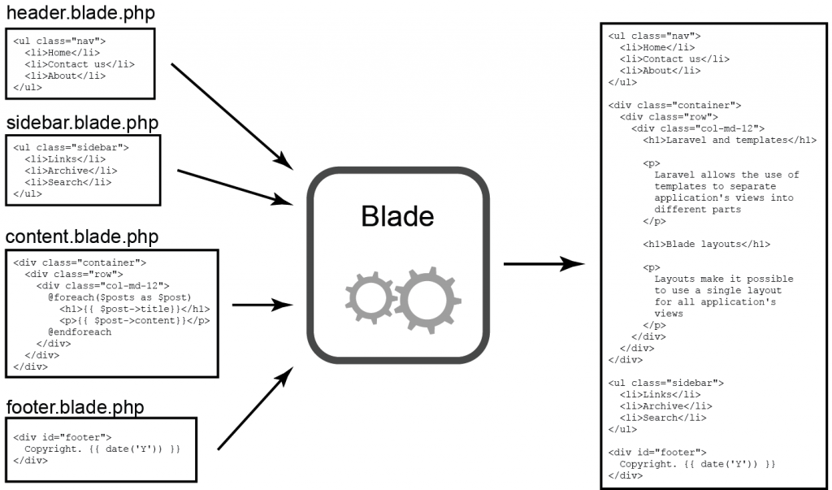
Blade
blade is a powerful template engine provided by Laravel
All the code inside blade file is compiled to static html file
support plain PHP

Slide 11
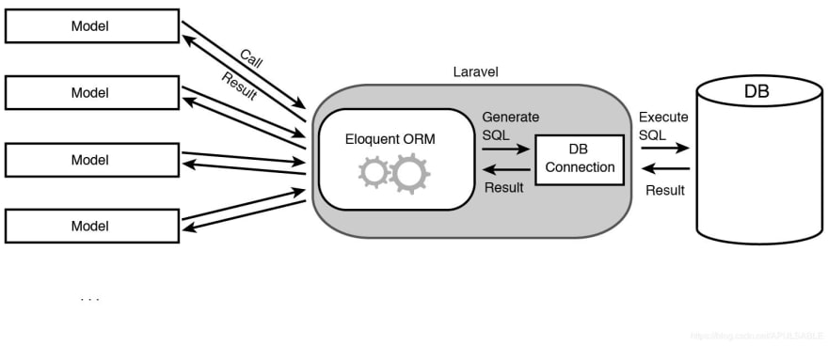
Eloquent & database
The Eloquent ORM included with Laravel provides a beautiful, simple ActiveRecord implementation for working with your database .
Each database table has a corresponding “model ” which is used to interact with that table

Slide 12
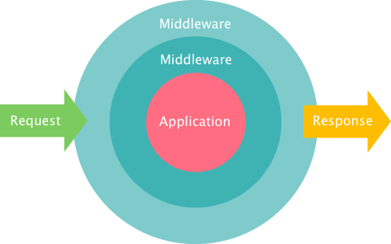
middleware
The middleware is mechanism for filtering the HTTP requests
Laravel include several middleware’s - Authentication, CSRF Protection
The auth middleware check if the user visiting the page is authenticated through session cookie
The CSRF token proctection middleware protects your application from cross- site request forgery attack by adding token key for each generated form

Slide 13
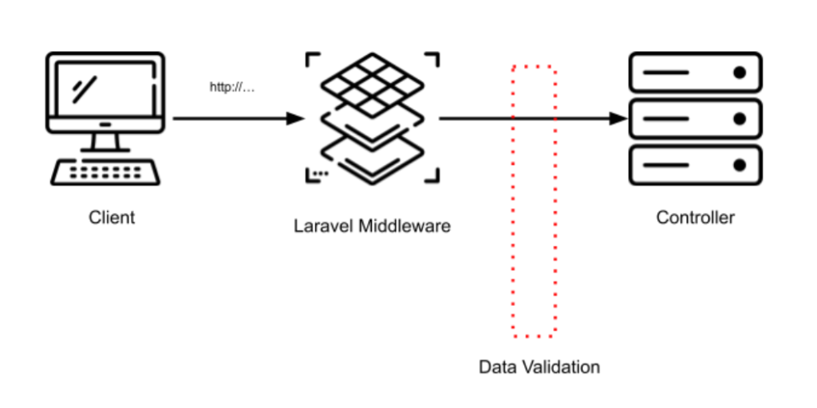
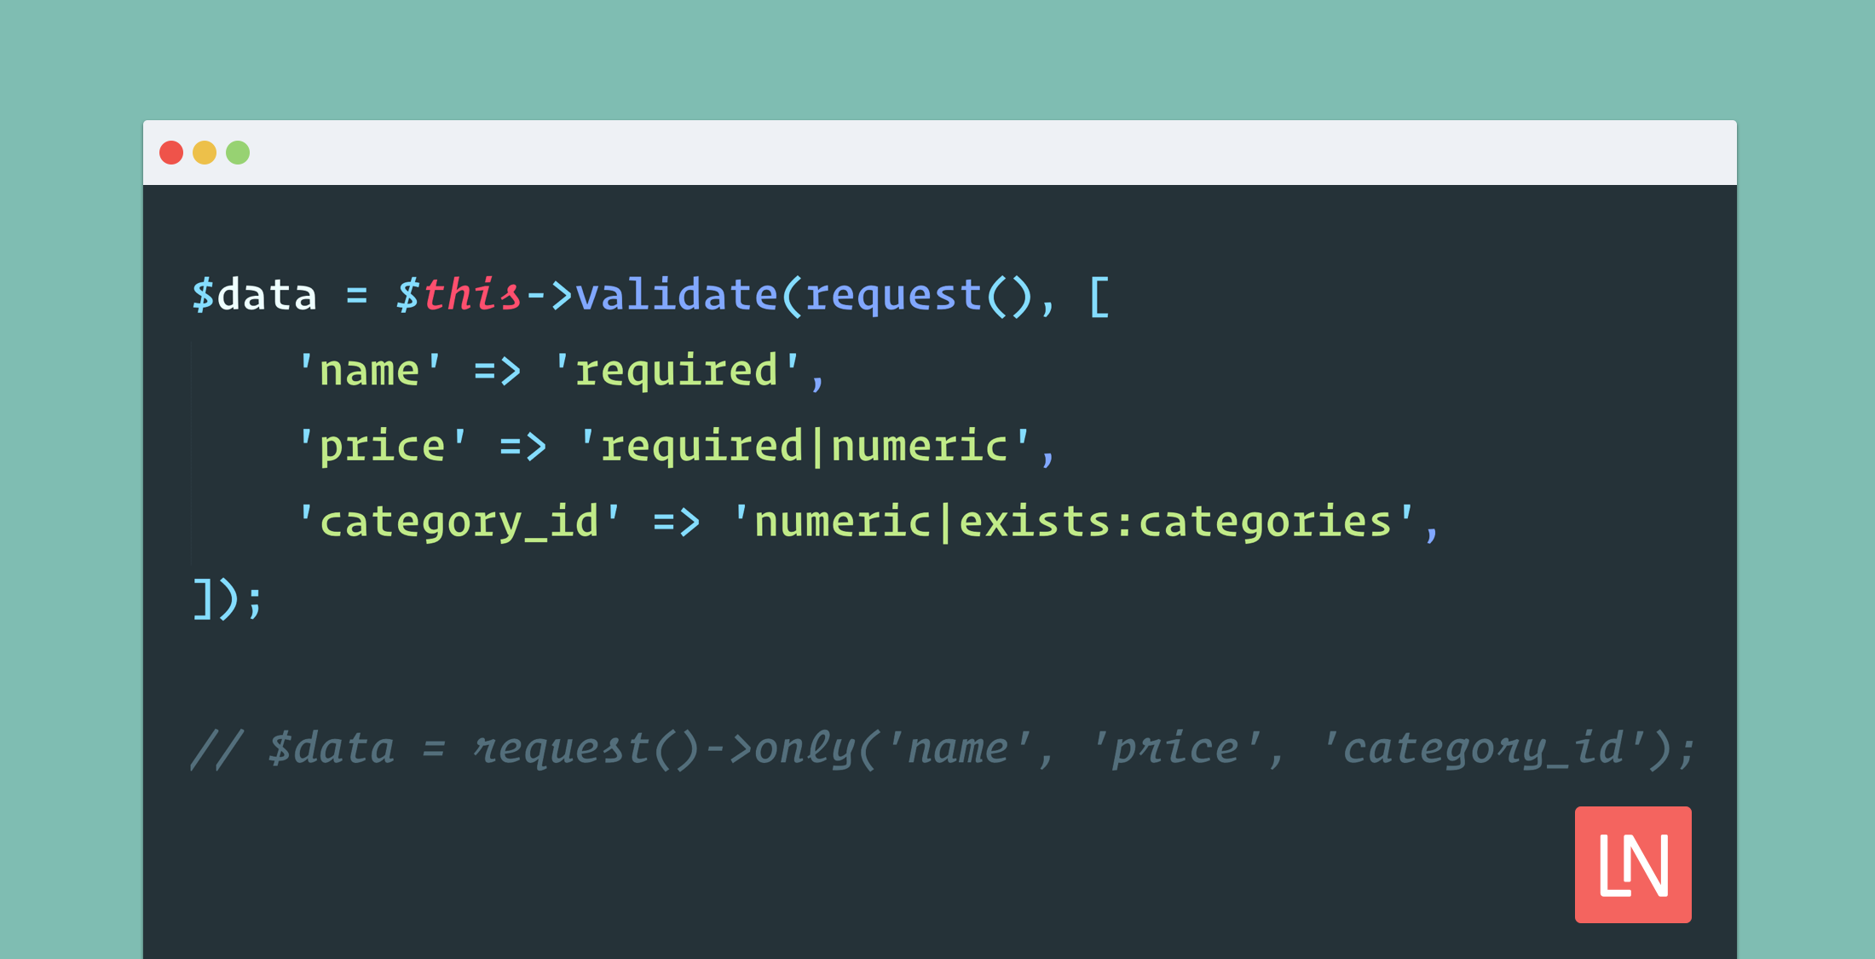
Validation :

Slide 14
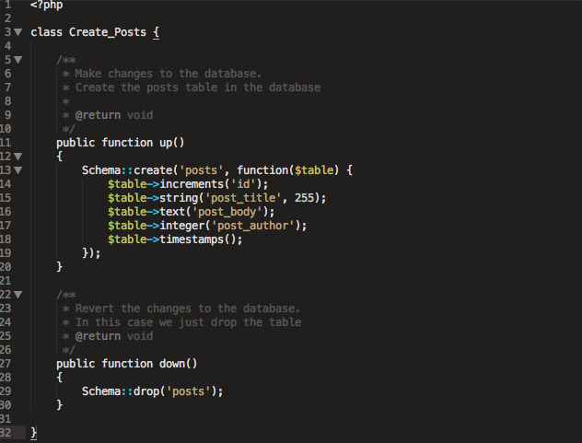
Model:

Slide 15
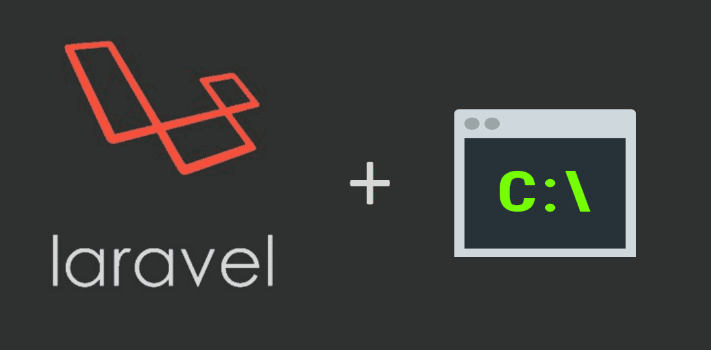
Artisan
Artisan is the command-line interface included with Laravel. It provides a number of helpful commands that can assist you while you build your application. This tool allows us to perform the majority of those repetitive and tedious programming tasks that most of the developers avoid performing manually.

Slide 16
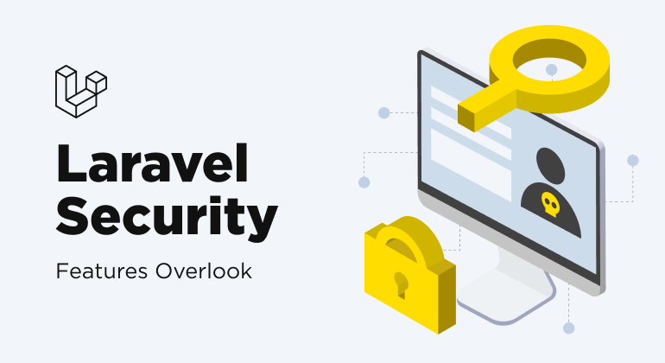

Slide 17
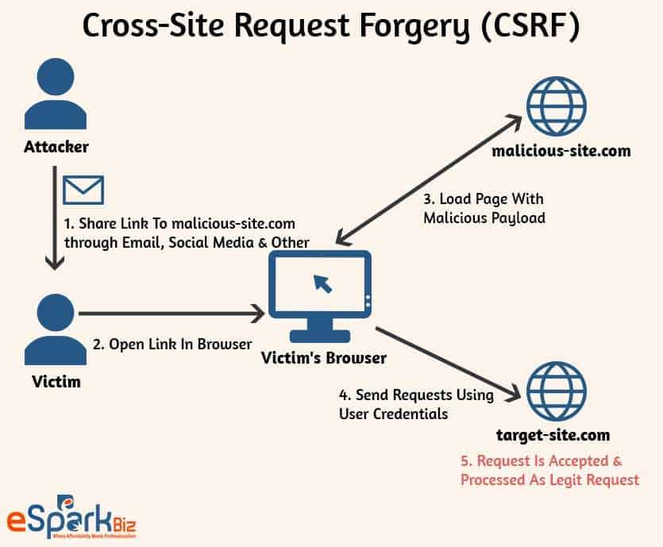
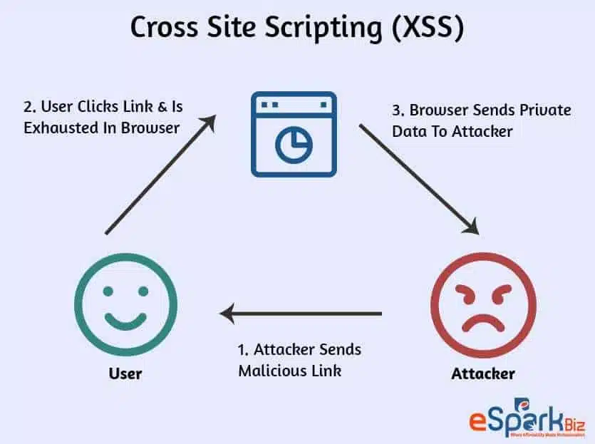
SECURITY

Slide 18
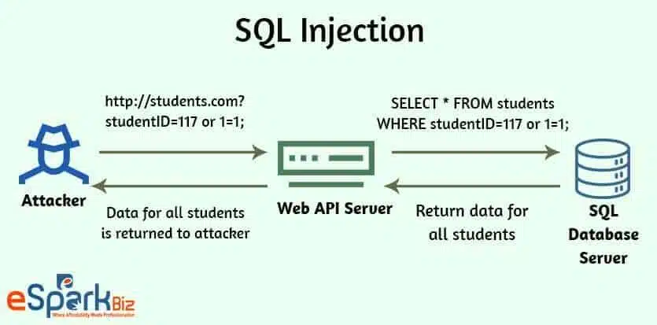
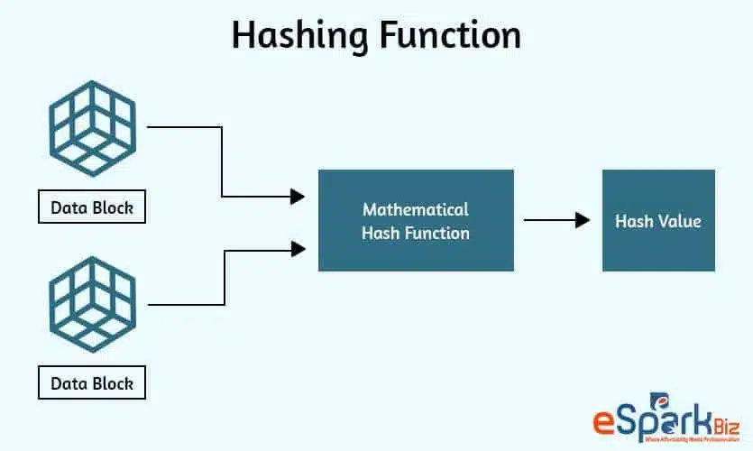
SECURITY

Slide 19
***

